Slide 1
Cellular Networks

Slide 2
Outline
An overview
Different generations in cellular communication systems
Introduction to 5G and 6G

Slide 3
An Overview
A cellular network (or mobile network as they are also known) is a wireless communication system that divides a geographic area into sections called cells.
Each cell is served by a base station and various other components working together enabling wireless communication to mobile and IoT (Internet of Things) devices.
Cell networks allow mobile devices to connect to the internet, make phone calls and send / receive texts or cellular data.
They do this by switching frequencies seamlessly as users move across different cells.

Slide 4
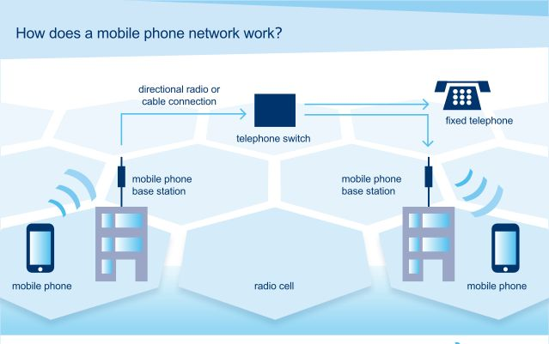

Slide 5
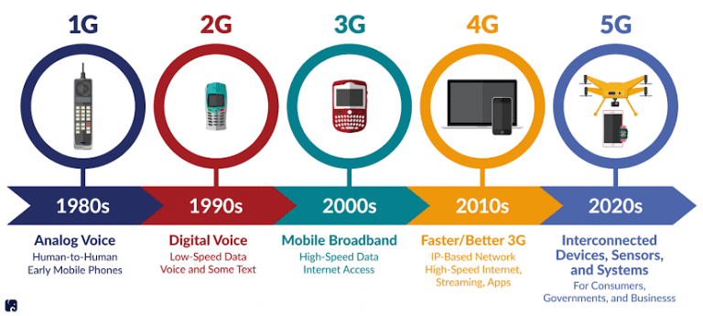
Different Generations in Cellular Networks

Slide 6
1G Networks (1st Generation)
Mobile telecommunications which was first introduced in 1980s and completed in early 1990s.
Speed was up to 2.4kbps.
The Operating frequency of 1G is 800 MHz and 900 MHz.
First-time calling was introduced in mobile systems.
It used analog signals.
The coverage area was small.
No roaming support between various operators.
Only the voice can be transmitted in 1G and its quality is very low.
Mobile Phones could not have a long life in battery usage and were very big which was very difficult to carry.

Slide 7
2G Networks (2nd Generation)
Shifted from analog to digital.
To have advancement over the 1G, the GSM (Global System for Mobile Communication) was introduced.
In the current technology, every system has the basis of GSM. This generation is responsible for the upgradation from voice calls to MMS (Multimedia Messaging System) and SMS (Short Message Systems).
The operating frequency of 2G is1.8GHz.
The data speed of 2G is nearly up to 64 Kbps.
The Voice quality also improved from 1G, it supports both voice and data.

Slide 8
2G Networks (2nd Generation) (contd…)
It needs strong network coverage for data transmission.
Even though it helps in sending messages, it cannot handle videos for transmission.

Slide 9
2.5G & 2.75G Networks
2.5G came after 2G which used the concept of GPRS.
(General Packet Radio Service, is a mobile data standard that provides internet access for 2G and 3G cellular networks). High data rate of 171kbps. Using the packet switching technique, the data is transferred, by dividing the data into small packets for an easy mode of transmission.
Then came 2.75G or EDGE(Enhanced Data Rates for GSM) with an increased data rate of up to 473.6 Kbps. Technology used is CDMA with a data rate of 384 Kbps. which was faster in providing services than 2.5G.
It supports Email transmission and Internet browsing and also features cameras in cellular phones.

Slide 10
3G Networks (3rd Generation)
It comes with data transfer technology such as UMTS (Universal Mobile Terrestrials System) for use in smartphones.
With this feature, we can have the video calling option and play games online on cellular phones.
Better system and capacity.
Offers high-speed wireless internet.
It supports both voice and data with a data rate of 3.1 Mbps.

Slide 11
3G Networks (3rd Generation) (contd…)
It has high security and international roaming.
The power consumption of using 3G technology is high.
The time taken to download via 3G is faster and more expensive to buy.

Slide 12
4G Networks (4th Generation)
LTE (Long term evaluation) & Wireless Fidelity (Wi-Fi) data technology are used.
It provides faster data rate to upload and download data.
Vo-LTE (Voice over LTE) is for both voice and the internet.
Freedom and flexibility to select any desired service with reasonable Quality of Service.
High usability.
Supports multimedia service at a low transmission cost.
HD Quality Streaming.
Speed:-100mbps.

Slide 13
4G Networks (4th Generation) (contd…)
The Data rate provides a capacity of 100Mbps to 1Gbps and is highly securable by using the Encryption Technique.
The Internet Service provided by 4G is Ultra-Broadband.
It provides high speed and global mobility using the internet and International calls.
It provides costlier hardware and infrastructure setup.
Due to the high data rate speed, the battery usage is less.

Slide 14
5G Networks (5th Generation)
Higher data rates.
Connectivity is more fast and more secure,
.Massive network capacity.
It is 30 times faster than 4G.
Faster loading speeds of real time applications such as maps & weather
The ability to have multiple people in video conferencing calls
Ability to stream high‐definition (HD).

Slide 15
Beyond 5G Networks
Beyond 5G" (B5G) primarily refers to the research and early development stages of 6G technology, which aims to expand on 5G's capabilities to enable a hyper-connected society where physical and digital worlds will merge.
Ultra-high data rates, integration with artificial intelligence (AI),
Seamless connectivity across all locations, including remote areas, oceans, and air.
Enables advanced Extended Reality (XR) applications, including holographic communication.
Focus on reducing power consumption in both devices and network infrastructure.

